Slide 1
RHESSys history, community, & processes
Lin and Band, Aug 2020

Slide 2
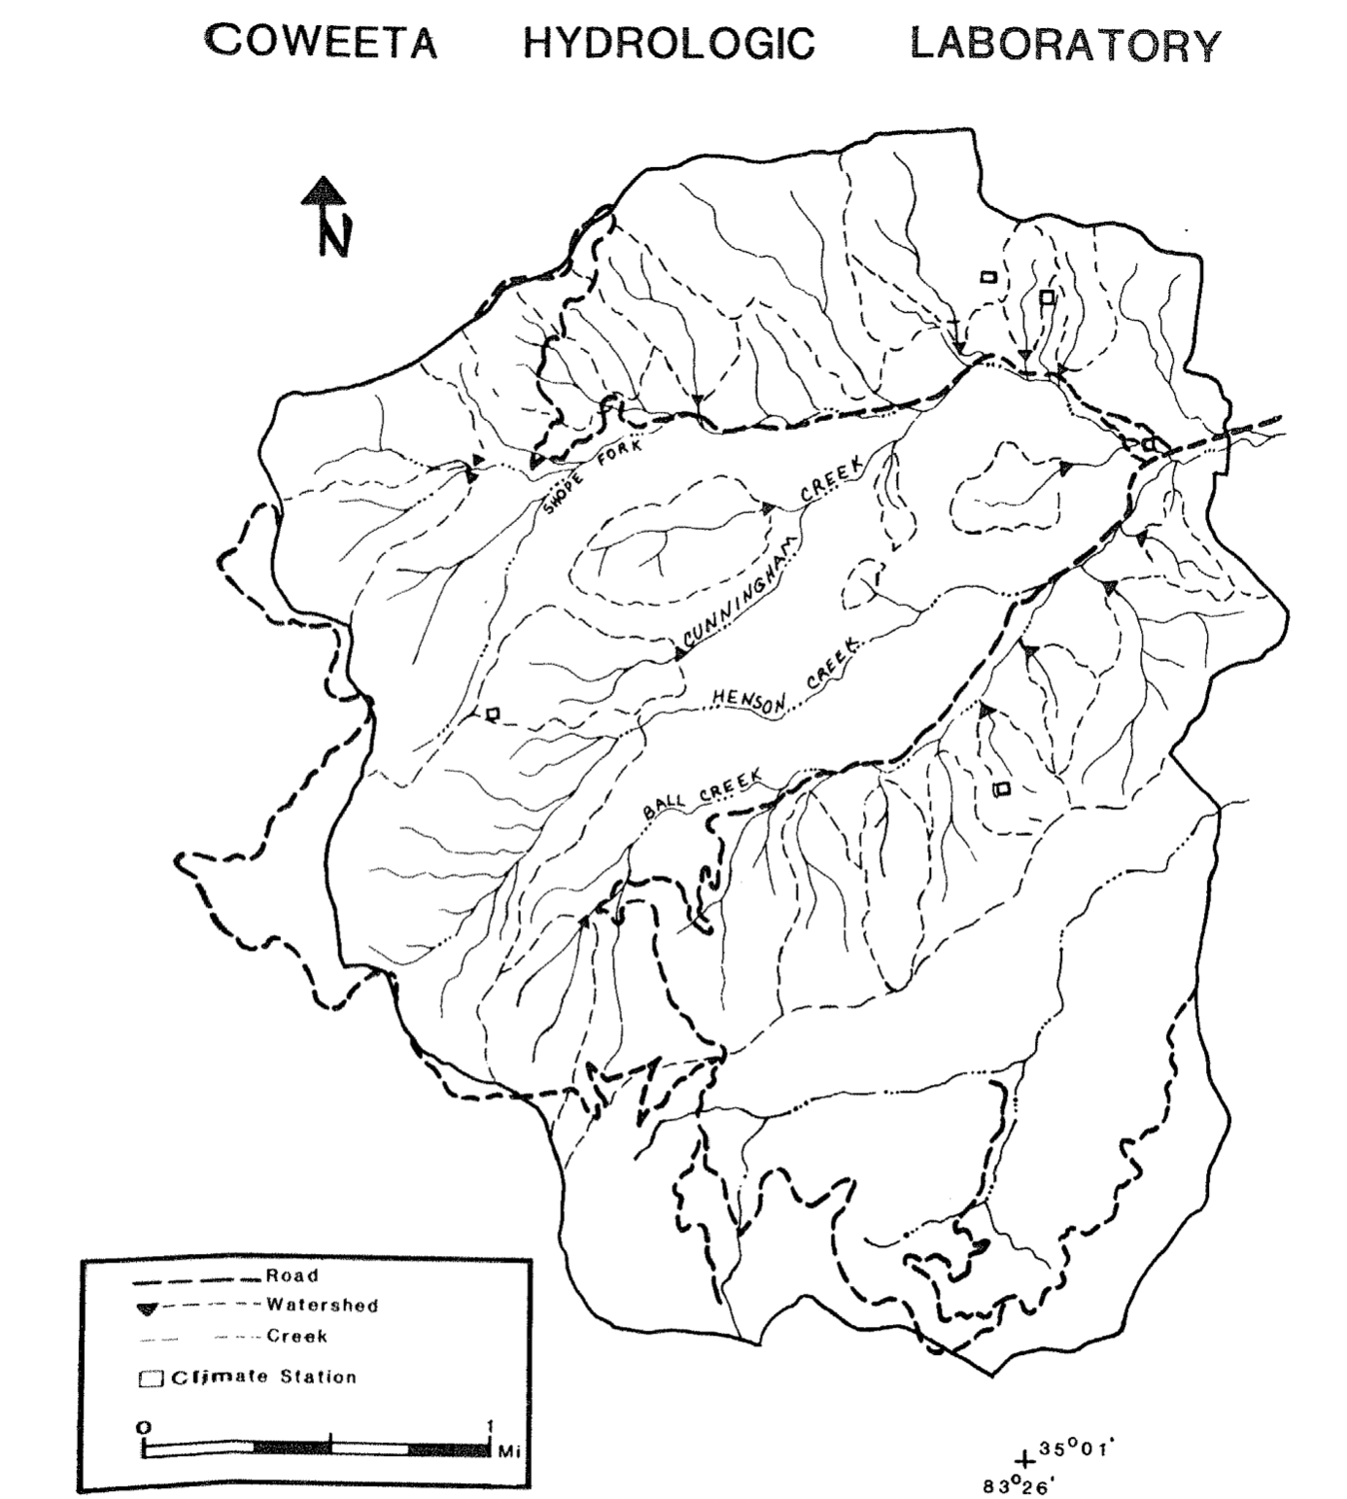
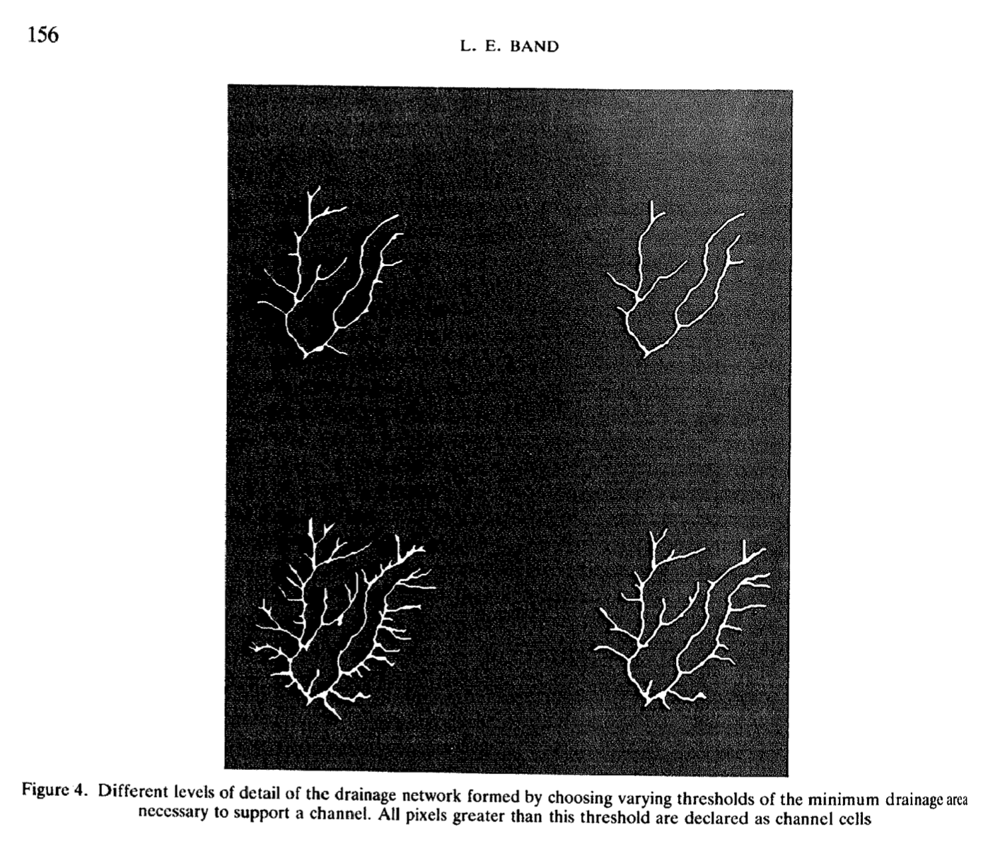
RHESSys (brief) history
RHESSys (Regional Hydro-Ecological Simulation System) is a GIS-based, terrestrial ecohydrologic modeling framework designed to simulate carbon, water and nutrient fluxes at the watershed scale. RHESSys models the temporal and spatial variability of ecosystem processes and interactions at a daily time step over multiple years by combining a set of physically based process models and a methodology for partitioning and parameterizing the landscape.
Band 1989, Band and Wood 1988
Elevation ->
slope
aspect
accumulative drainage area
Hillslopes
stream network
Watershed delineation

Slide 3
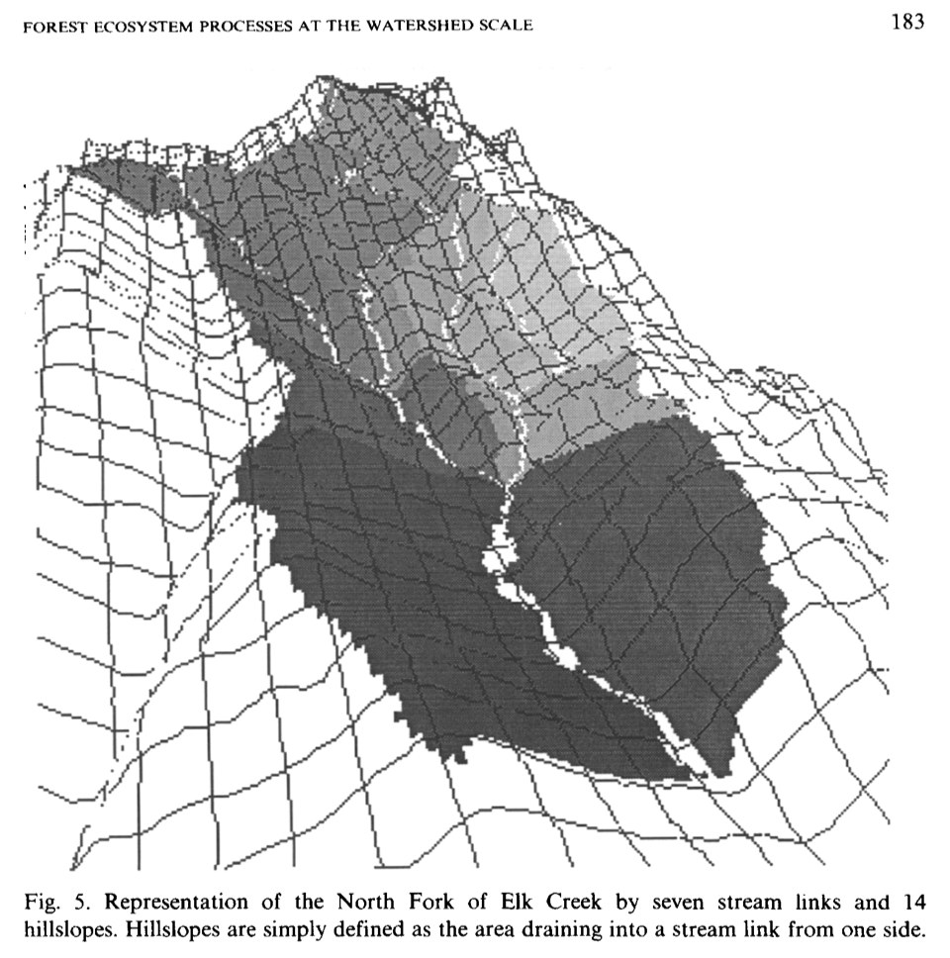
RHESSys (brief) history
RHESSys (Regional Hydro-Ecological Simulation System) is a GIS-based, terrestrial ecohydrologic modeling framework designed to simulate carbon, water and nutrient fluxes at the watershed scale. RHESSys models the temporal and spatial variability of ecosystem processes and interactions at a daily time step over multiple years by combining a set of physically based process models and a methodology for partitioning and parameterizing the landscape.
Band 1989, Band and Wood 1988
Band 1991; Band et al., 1991
Incorporated MT-CLIM to extrapolate the base station climatic data according to elevation, aspect, and gradient through the surrounding complex terrain
Couple Forest_BGC with geographic information processing -> spatial pattern of ET and NPP
Climate
Precipitation -> snowpack
-> soil water
-> canopy interception
-> through fall
-> snowmelt water
Climate
Climate
ET
PSN
ET
PSN
Canopy photosynthesis based on [CO2], radiation, temperature, LAI, canopy conductance, day length
ET
PSN

Slide 4
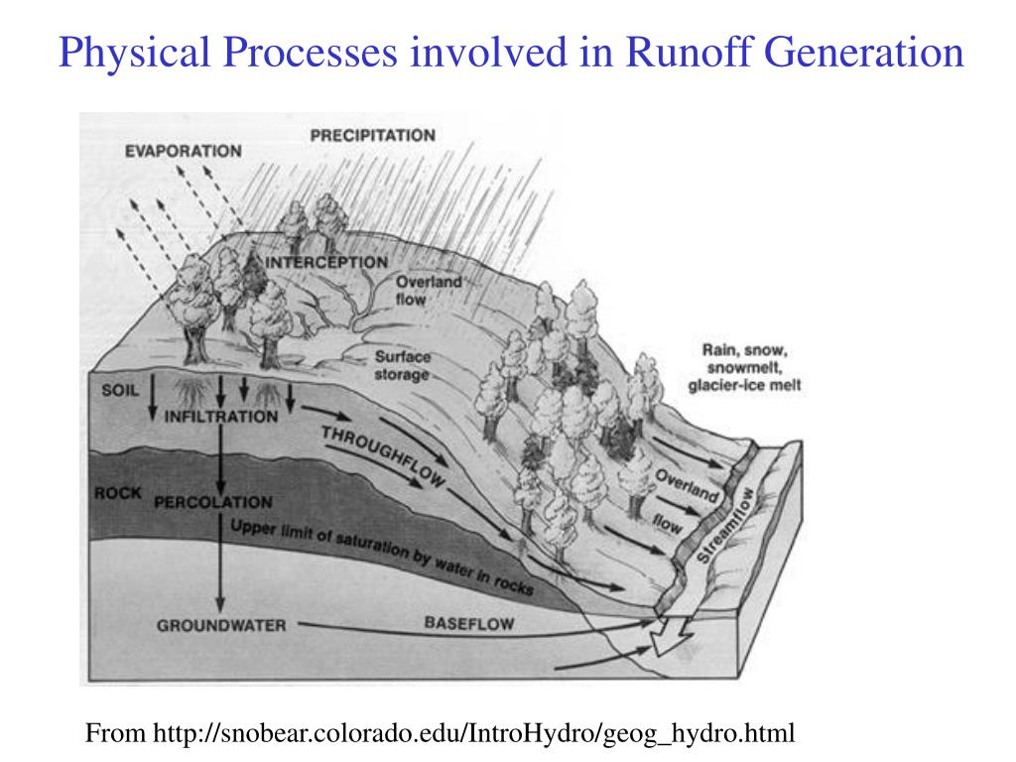
RHESSys (brief) history
RHESSys (Regional Hydro-Ecological Simulation System) is a GIS-based, terrestrial ecohydrologic modeling framework designed to simulate carbon, water and nutrient fluxes at the watershed scale. RHESSys models the temporal and spatial variability of ecosystem processes and interactions at a daily time step over multiple years by combining a set of physically based process models and a methodology for partitioning and parameterizing the landscape.
Band 1989, Band and Wood 1988
Band 1991; Band et al., 1991
Band, Patterson, Nemani, & Running, 1993; Nemani, Running, Band, and Peterson, 1993
MT-CLIM
Forest-BGC (Running and Coughlan, 1988)
TOPMODEL Beven and Kirby, 1979
Climate
Climate
Climate
ET
PSN
ET
PSN
ET
PSN
Lateral redistribution of resources

Slide 5

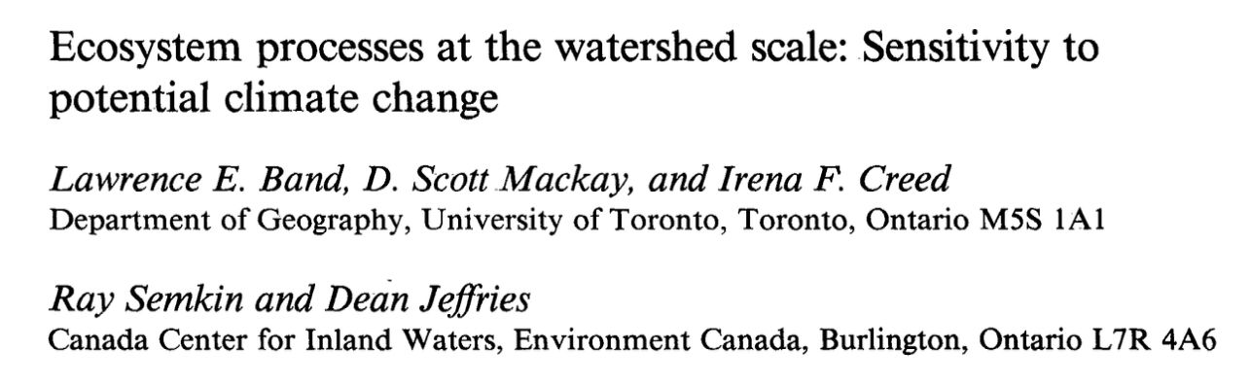



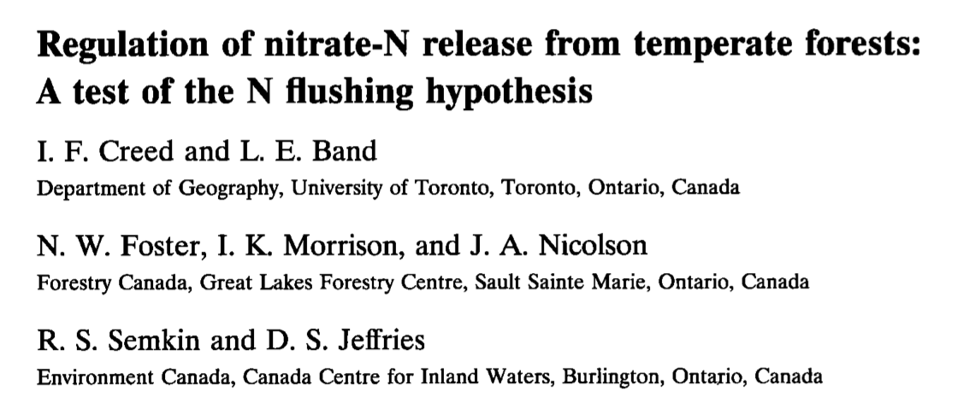

RHESSys (brief) history
RHESSys (Regional Hydro-Ecological Simulation System) is a GIS-based, terrestrial ecohydrologic modeling framework designed to simulate carbon, water and nutrient fluxes at the watershed scale. RHESSys models the temporal and spatial variability of ecosystem processes and interactions at a daily time step over multiple years by combining a set of physically based process models and a methodology for partitioning and parameterizing the landscape.
Band 1989, Band and Wood 1988
Band 1991; Band et al., 1991
Band, Patterson, Nemani, & Running, 1993; Nemani, Running, Band, & Peterson, 1993
Band, Mackay, Creed, Semkin, & Jeffries, 1996; Creed, Band, Foster, Morrison, Nicolson, Semkin, &Jeffries, 1997; Mackey and Band, 1997; Lammers et al. 1997

Slide 6

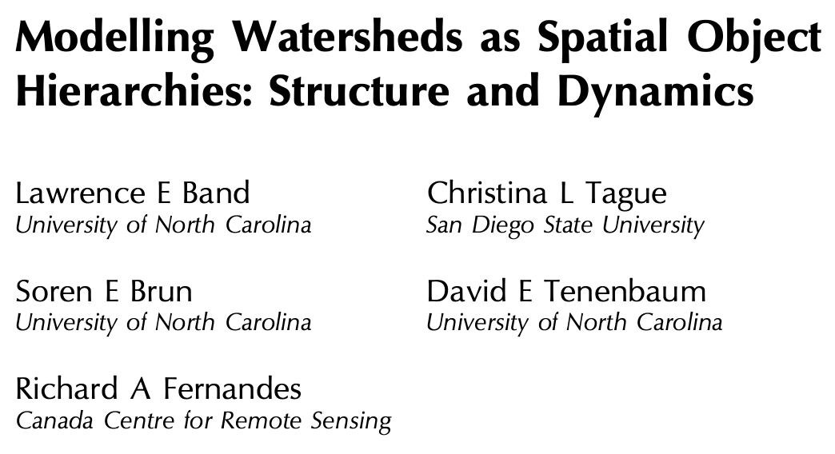

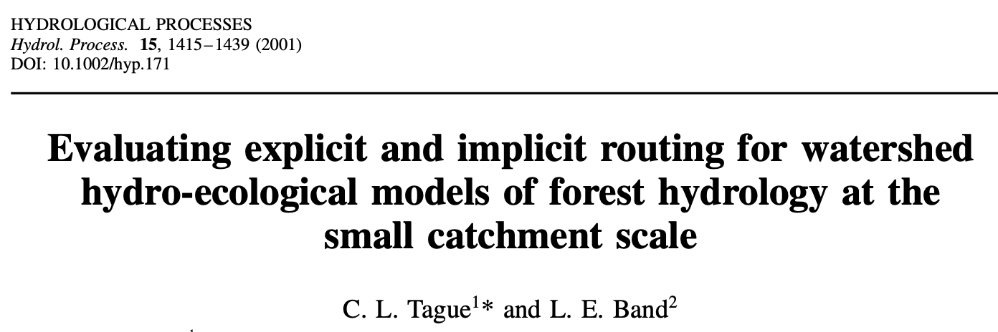

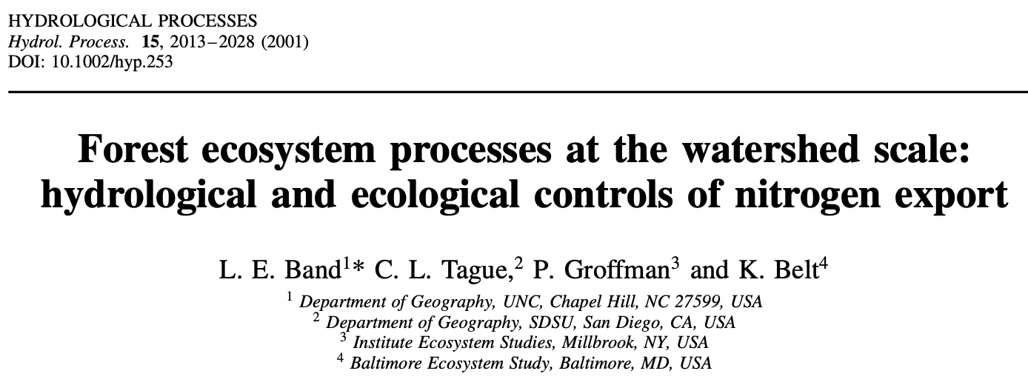

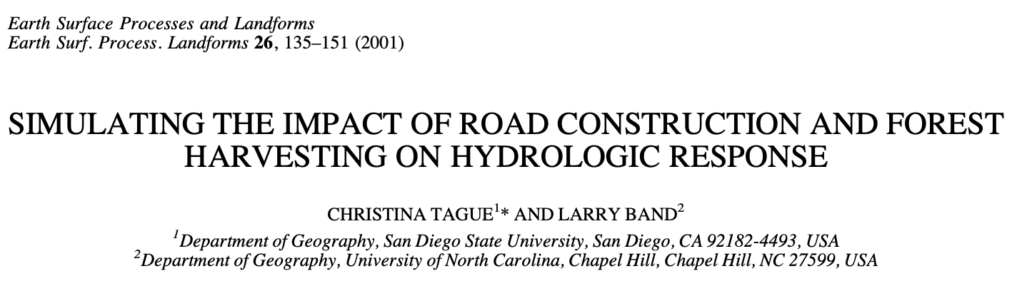
RHESSys (brief) history
RHESSys (Regional Hydro-Ecological Simulation System) is a GIS-based, terrestrial ecohydrologic modeling framework designed to simulate carbon, water and nutrient fluxes at the watershed scale. RHESSys models the temporal and spatial variability of ecosystem processes and interactions at a daily time step over multiple years by combining a set of physically based process models and a methodology for partitioning and parameterizing the landscape.
Band 1989, Band and Wood 1988
Band 1991; Band et al., 1991
Band, Patterson, Nemani, & Running, 1993; Nemani, Running, Band, & Peterson, 1993
Band, Mackay, Creed, Semkin, & Jeffries, 1996; Creed, Band, Foster, Morrison, Nicolson, Semkin, &Jeffries, 1997; Mackey and Band, 1997; Lammers et al. 1997
Band, Tague, Brun, Tecenbaum, & Fernandes, 2000; Tague and Band, 2001; Band, Tague, Groffman, & Belt, 2001; Tague and Band, 2001b
Distributed Hydrology Soil Vegetation Model (DHSVM) Wigmosta, Vail, & Lettenmaier, 1994
N cycling and export
Event controls (tecfiles)

Slide 7
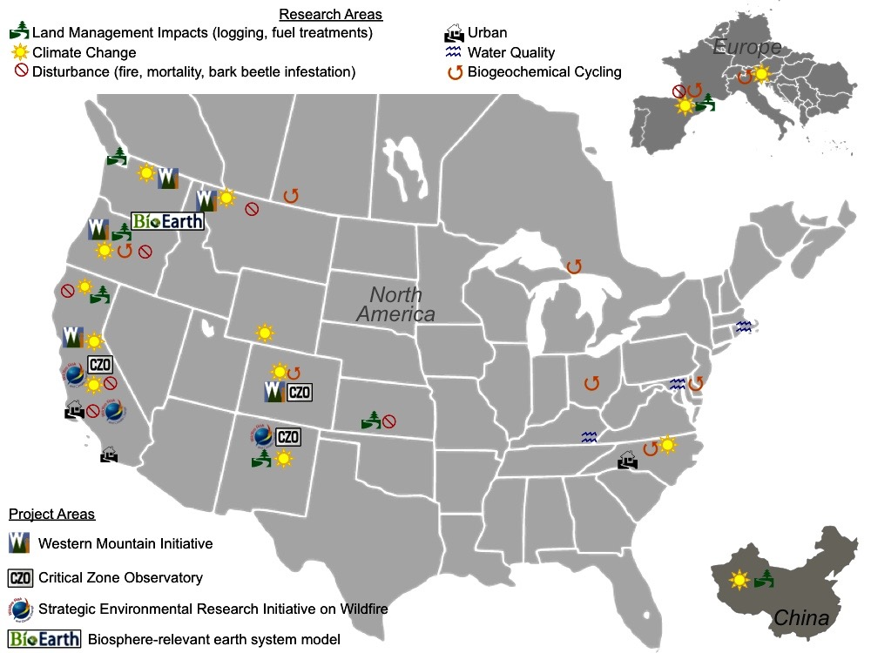
RHESSys catchments
Information provided by Naomi Tague [https://tagueteamlab.org/portfolio/where-is-rhessys-being-used/]

Slide 8

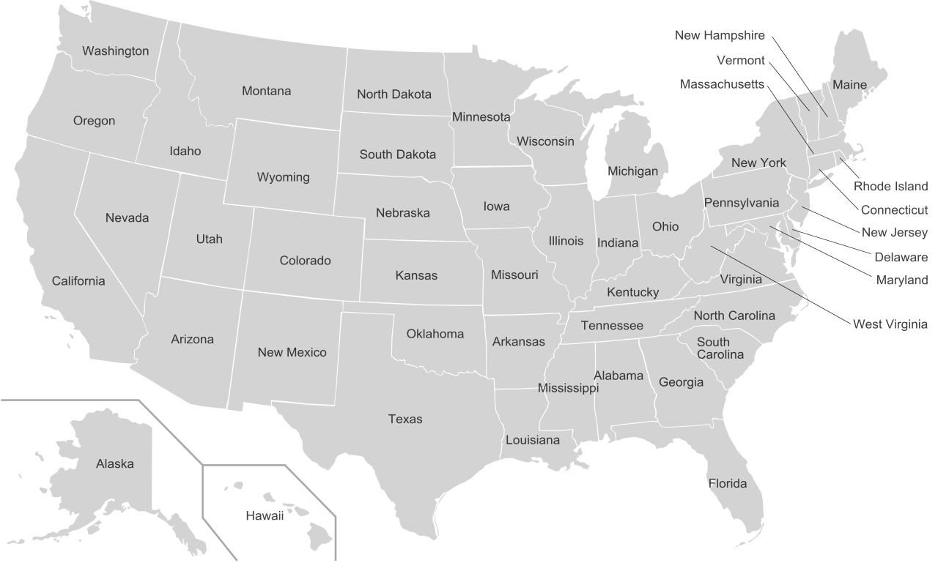






RHESSys community

Slide 9

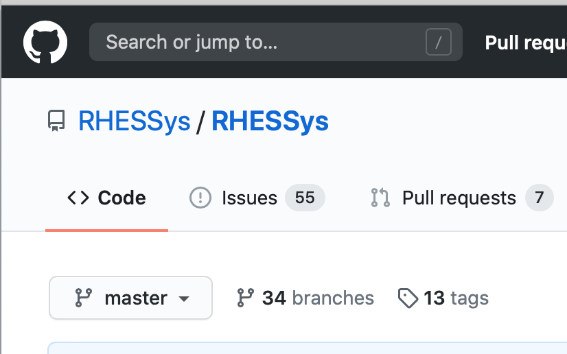
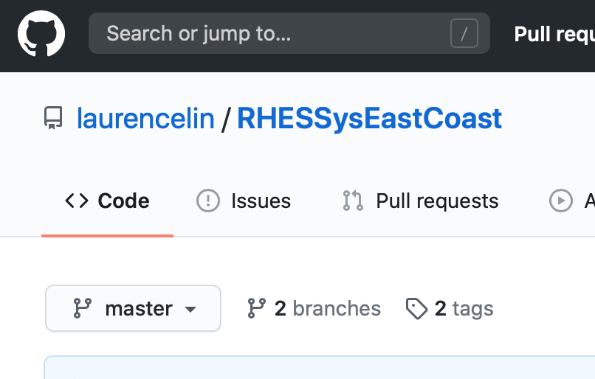

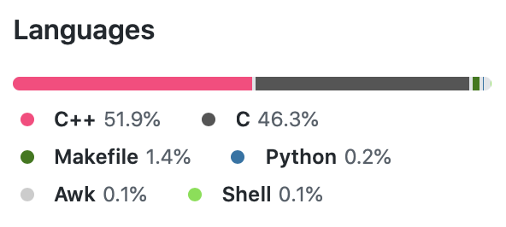
RHESSys coding community
One of the branches that is adapted to East Coast environments and projects
Refining hydrology and ecosystem interactions
Improving model for urban catchments
Making technical improvements

Slide 10
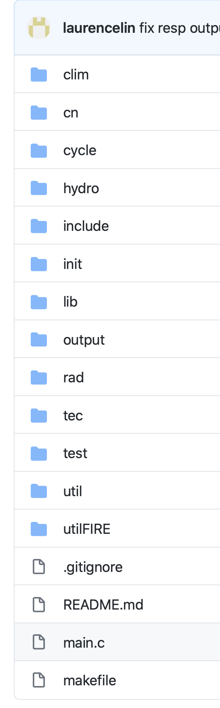
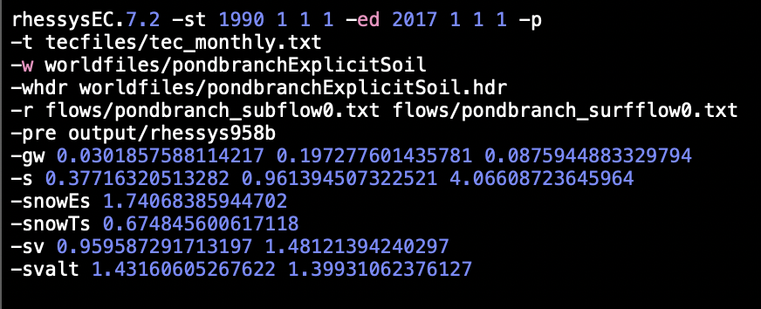
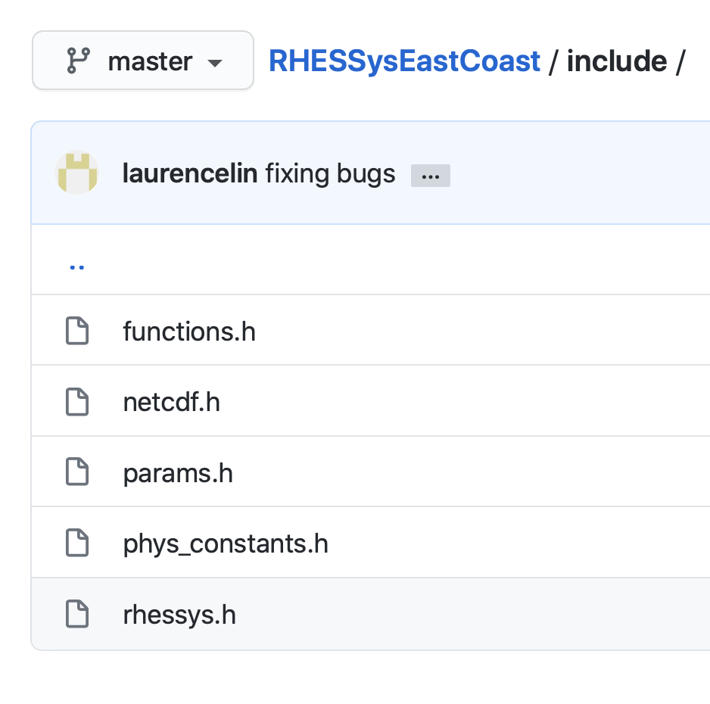
RHESSys

Slide 11

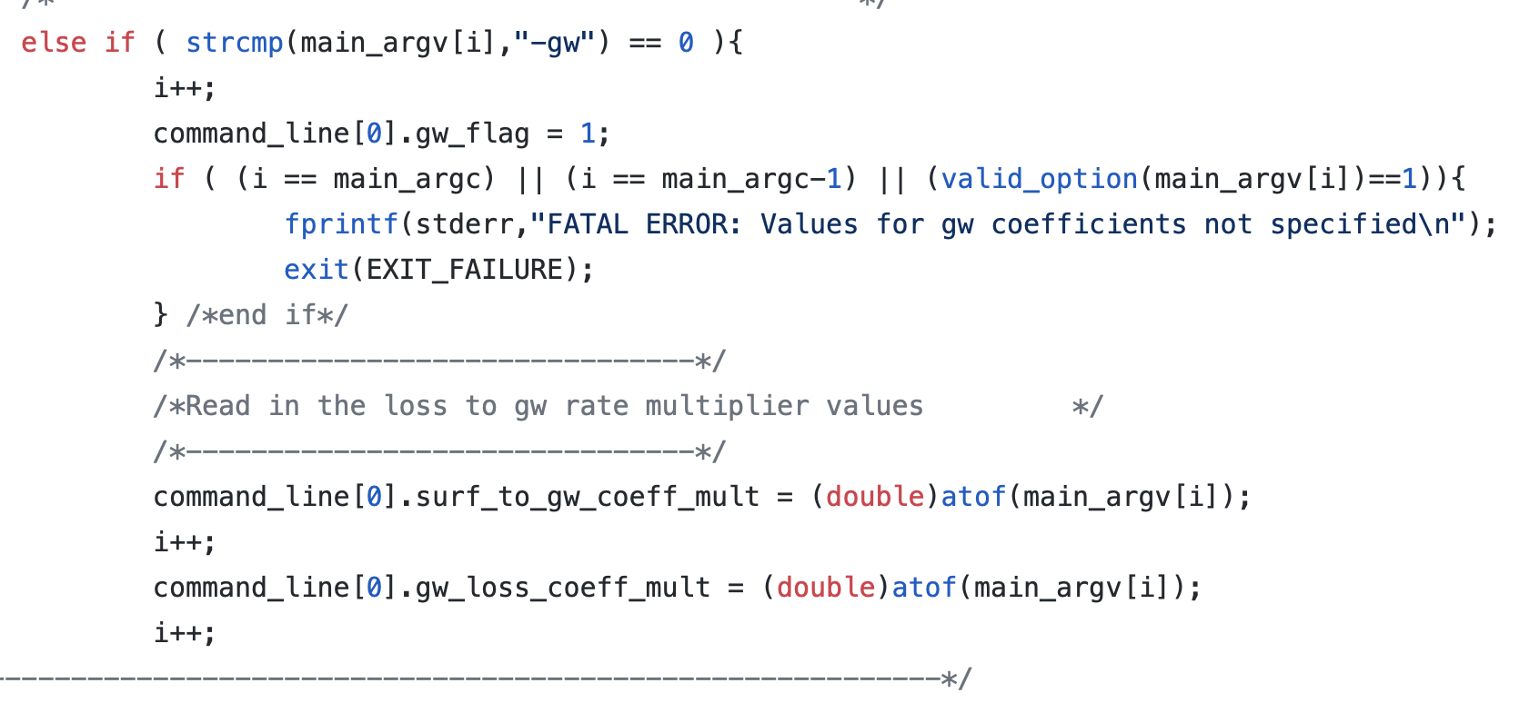
RHESSys

Slide 12
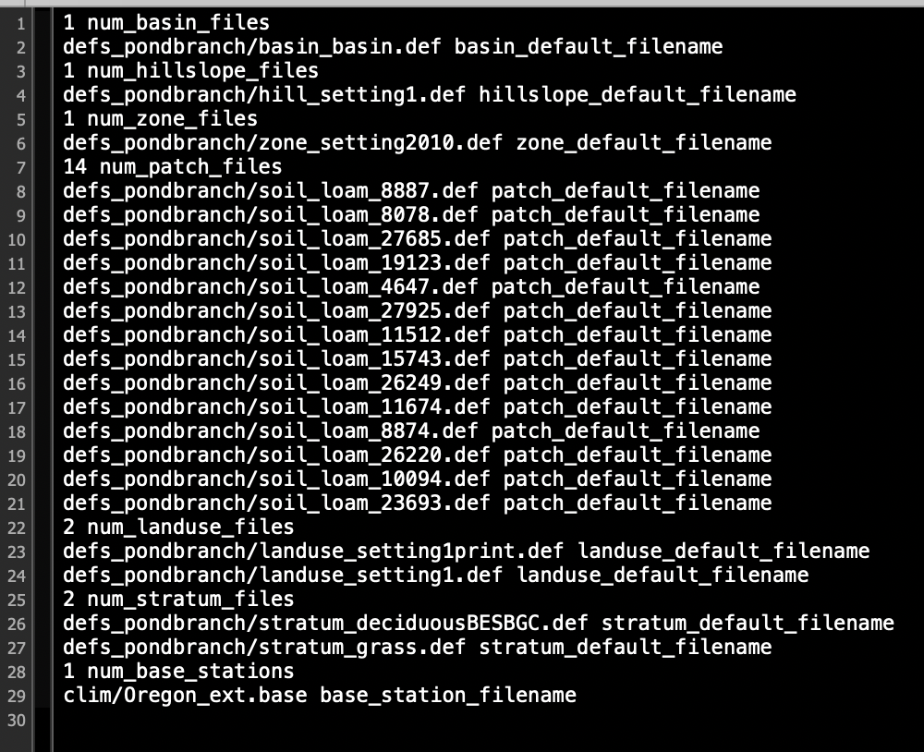
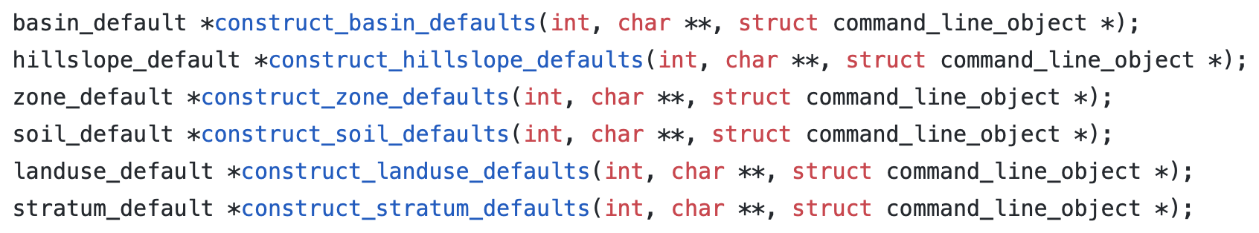
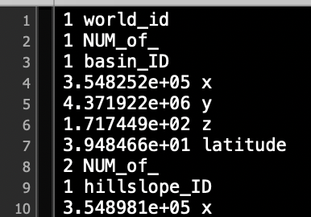
RHESSys
Header file
Worldfile

Slide 13
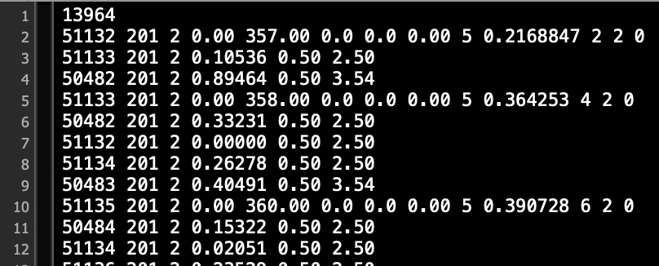
RHESSys
Flowtable

Slide 14




Patch
Daily precipitation comes from zone and station time series
A fixed sized canopy store to hold canopy interception
Throughfall to non-fixed sized surface detention
Water holding capacity is within surface detention
Litter interception
Urban impervious surface water detention
Detention - Litter interception is subject to infiltration
Detention - Litter interception - infiltration is subject to surface lateral transport
Transpiration
Precipitation
Evaporation
Canopy interception
Throughfall
Surface water (detention)
Returnflow
litter interception
Infiltration
Unsaturation Zone
RZ water (RZ storage)
(rz FC)
FC
(Rz Drain)
Rooting depth
(unsat FC)
Rain intensity
<
Soil vertical conductivity
>
Cap. Rise
Intermission water (unsat storage)
Rain intensity
Soil vertical conductivity
GW2Riparian
Drainage
infil. = Precip * (1-%imp.)
(Unsat Drain)
Soil depth
This runs in daily; it will be balanced by return flow, drainage, and lateral transport
Hillslope GW

Slide 15
Patch
Unsaturation zone is partitioned into two zones:
“Root zone” (a fixed depth, e.g., 0.6 - 1 m)
Intermission zone (may not exist if water table rises)
Vegetation can access water within the “root zone”
Unsaturation Soil water = root zone water + intermission zone water
unsaturation Soil water > FC(water table depth) -> drainage (from unsaturation to saturation zones)
unsaturation Soil water < FC(water table depth) -> capillary rise (from saturation to unsaturation zones and distributed to root zone and intermission zone
Saturation zone was used be assumed bottomless or very deep but is now bounded by a spatially distributed finite soil depth (extracted, interpolated, and calibrated)
RHESSys also has snowpack accumulation and melting processes but not mentioned or graphically represented here
Transpiration
Precipitation
Evaporation
Canopy interception
Throughfall
Surface water (detention)
Returnflow
litter interception
Infiltration
Unsaturation Zone
RZ water (RZ storage)
(rz FC)
FC
(Rz Drain)
Rooting depth
(unsat FC)
Cap. Rise
Intermission water (unsat storage)
GW2Riparian
Drainage
(Unsat Drain)
Soil depth
Hillslope GW

Slide 16
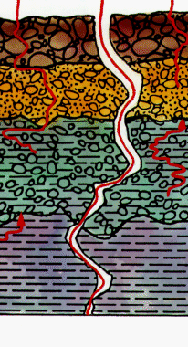
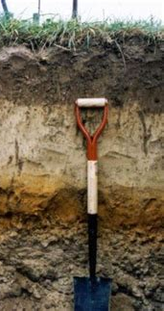
Patch
Fracture flow (from near surface to GW); gw1 (0 - 0.2)
A new gw3 (0 - 0.2) calibration parameter is added to described the leaching from the bottom soil column to GW
Outflow from GW could be at basin outlet as part of streamflow or discharge into the unsaturation zone at the cove area (likely riparian area); required “riparian” setting in the flow tables and -gw2riparian flag in the command line
Transpiration
Precipitation
Evaporation
Canopy interception
Throughfall
Surface water (detention)
Returnflow
litter interception
Infiltration
Unsaturation Zone
RZ water (RZ storage)
(rz FC)
FC
(Rz Drain)
Rooting depth
(unsat FC)
Cap. Rise
Intermission water (unsat storage)
GW2Riparian
Drainage
(Unsat Drain)
Prop. of water cannot drain out
Soil depth
Hillslope GW

Slide 17
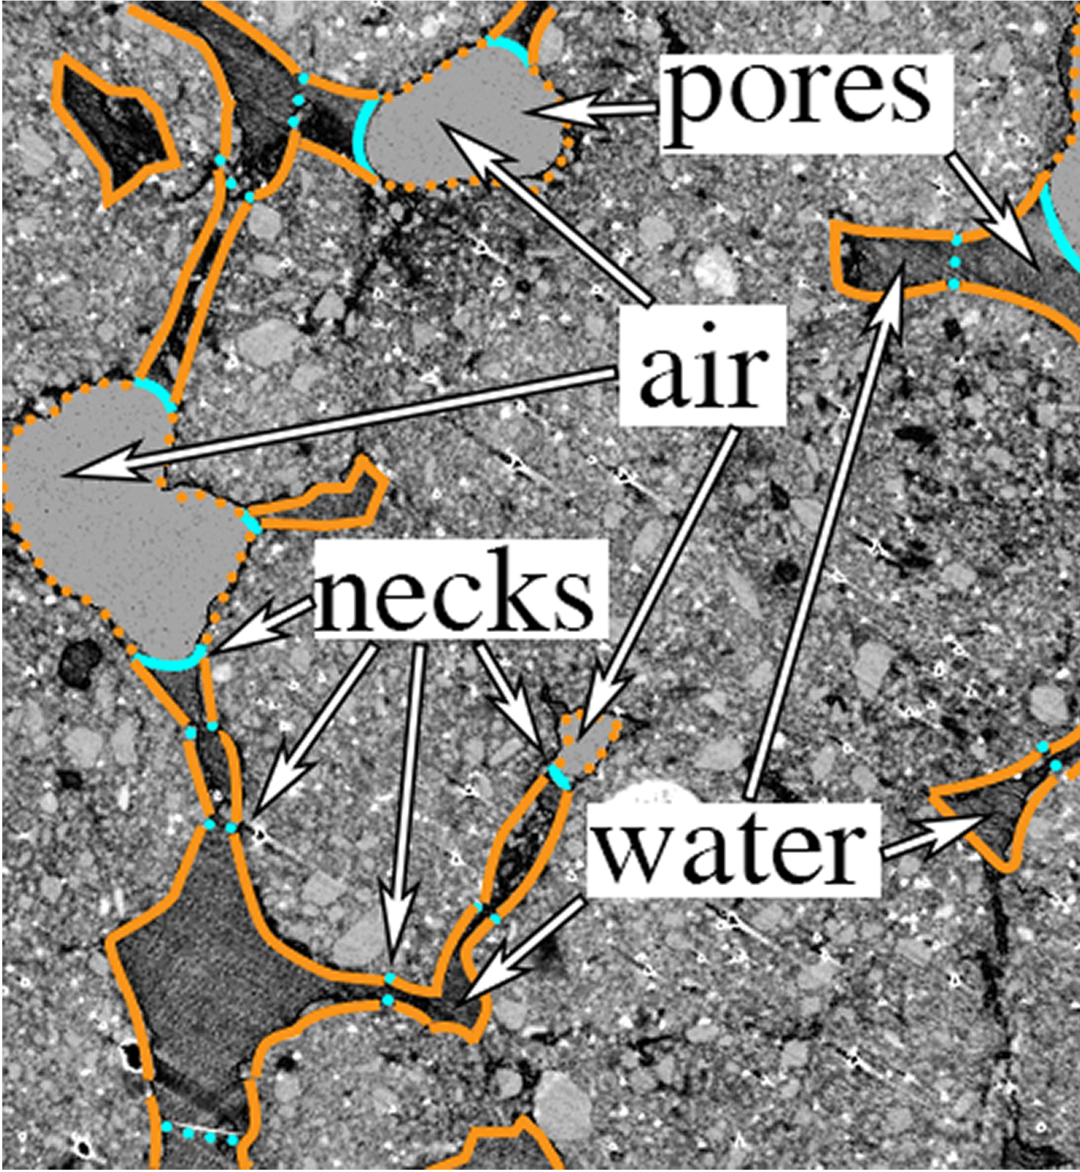
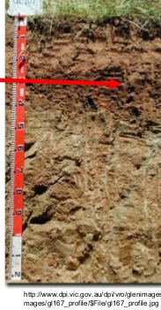
Patch
Poros = space in soil column that can hold water
Poros space may or may not be uniform in the soil column; Porosity profile
Other soil characters:
Saturation conductivity -> transmissivity, infiltration, drainage, cap.rise
Porosity -> sat.deficit
Texture; %sand, %clay, and %silt -> denitrification and nitrification
Organic matter content -> decomposition, immobilization, mineralization
Pore size index -> FC, transmissivity, cap.rise
Psi air entry -> FC, transmissivity, cap.rise
Thickness of horizon B and C -> active zone depth for denitrification and nitrification
Adsorption for solutes -> solute lateral transport
Transpiration
Precipitation
Evaporation
Canopy interception
Throughfall
Surface water (detention)
Returnflow
litter interception
Infiltration
Porosity profile
Conductivity
Unsaturation Zone
RZ water (RZ storage)
(rz FC)
FC
(Rz Drain)
Rooting depth
(unsat FC)
Cap. Rise
Intermission water (unsat storage)
GW2Riparian
Lateral transport
Drainage
Transmissivity
(Unsat Drain)
Prop. of water cannot drain out
Soil depth
Hillslope GW

Slide 18
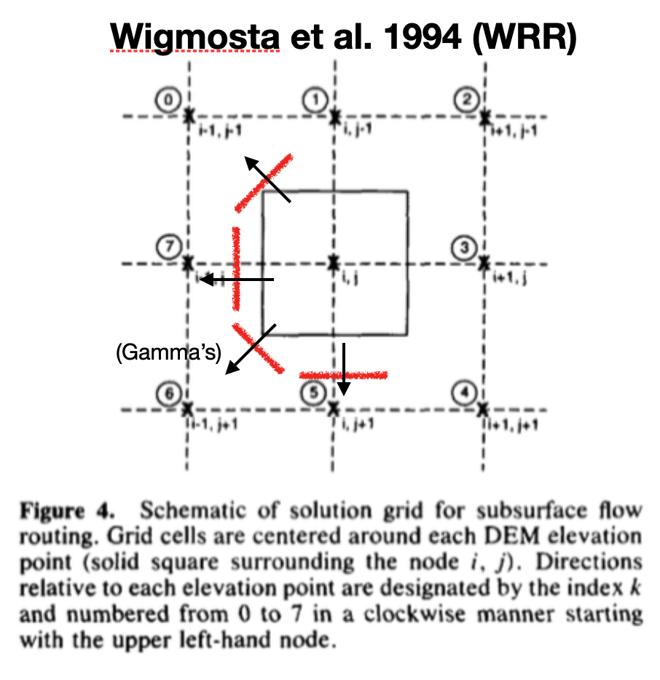
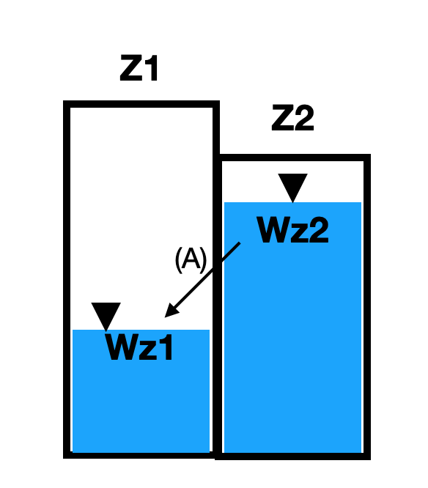
Patch
Transpiration
Precipitation
Evaporation
Canopy interception
Throughfall
Surface water (detention)
Returnflow
Saturation lateral transport
Gradient of water table
Distance (between patches)
Perimeter (DHSVM)
Water table depth (sat_def_z)
Conductivity profile
Porosity profile
litter interception
Infiltration
Porosity profile
Conductivity
Unsaturation Zone
RZ water (RZ storage)
(rz FC)
FC
(Rz Drain)
Rooting depth
(unsat FC)
Cap. Rise
Intermission water (unsat storage)
GW2Riparian
Lateral transport
Drainage
Transmissivity
(Unsat Drain)
Prop. of water cannot drain out
Soil depth
Hillslope GW

Slide 19
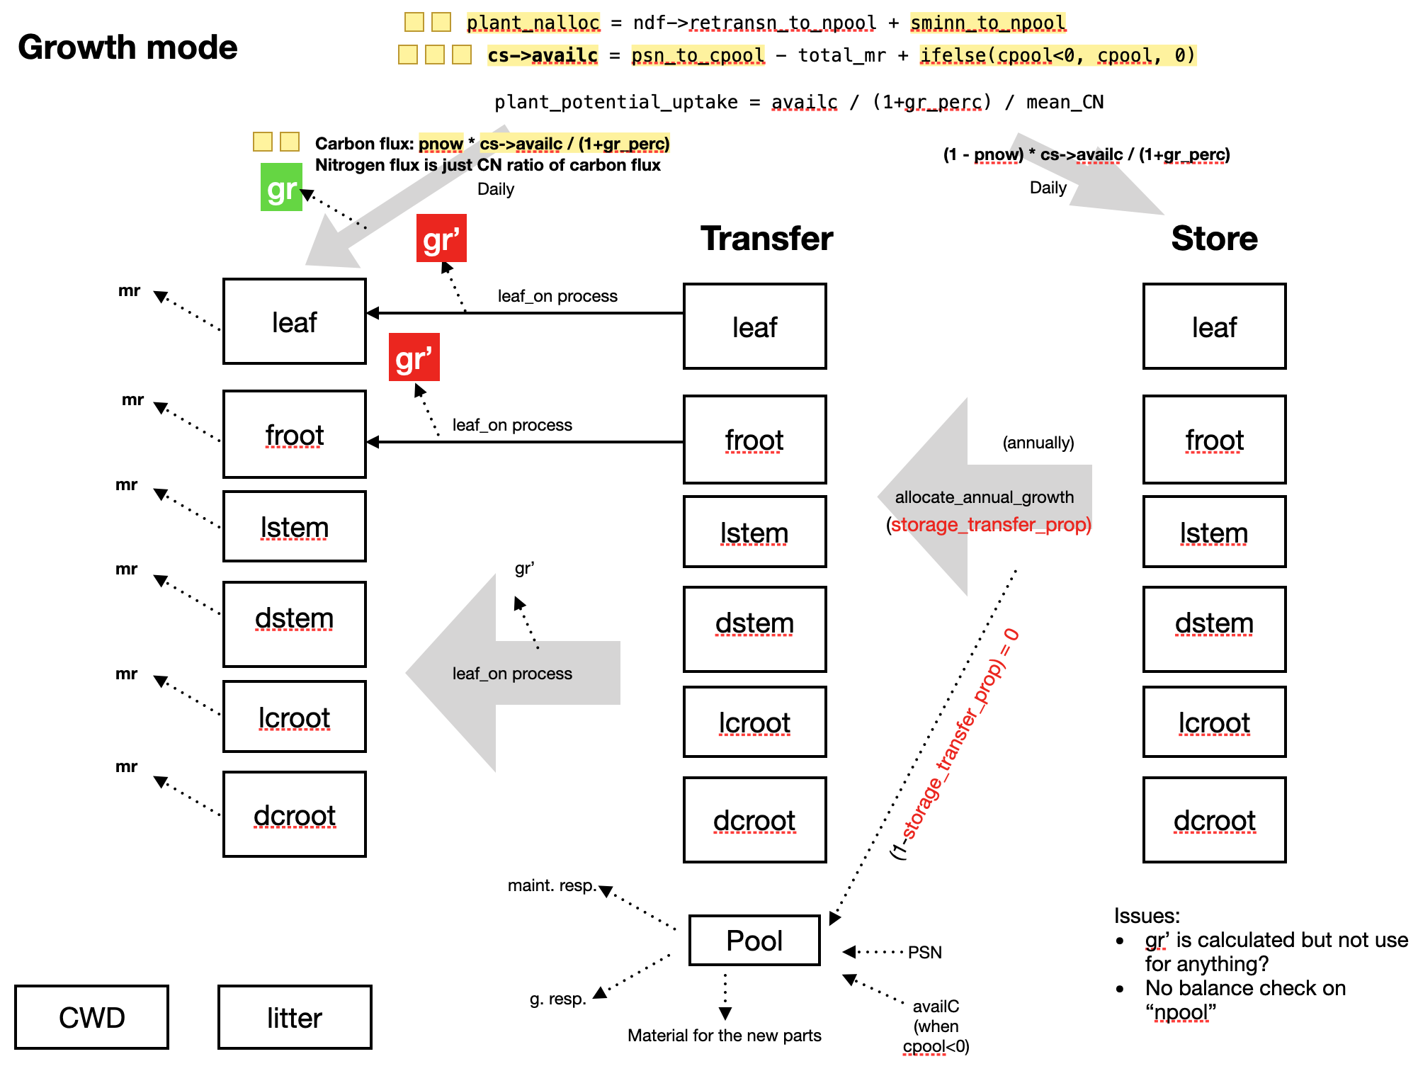
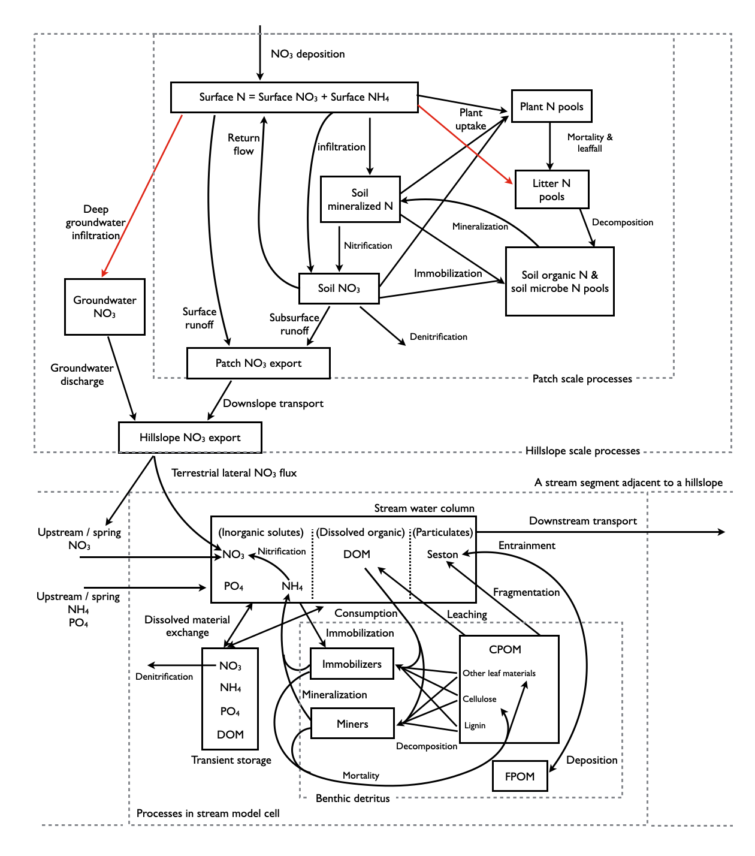
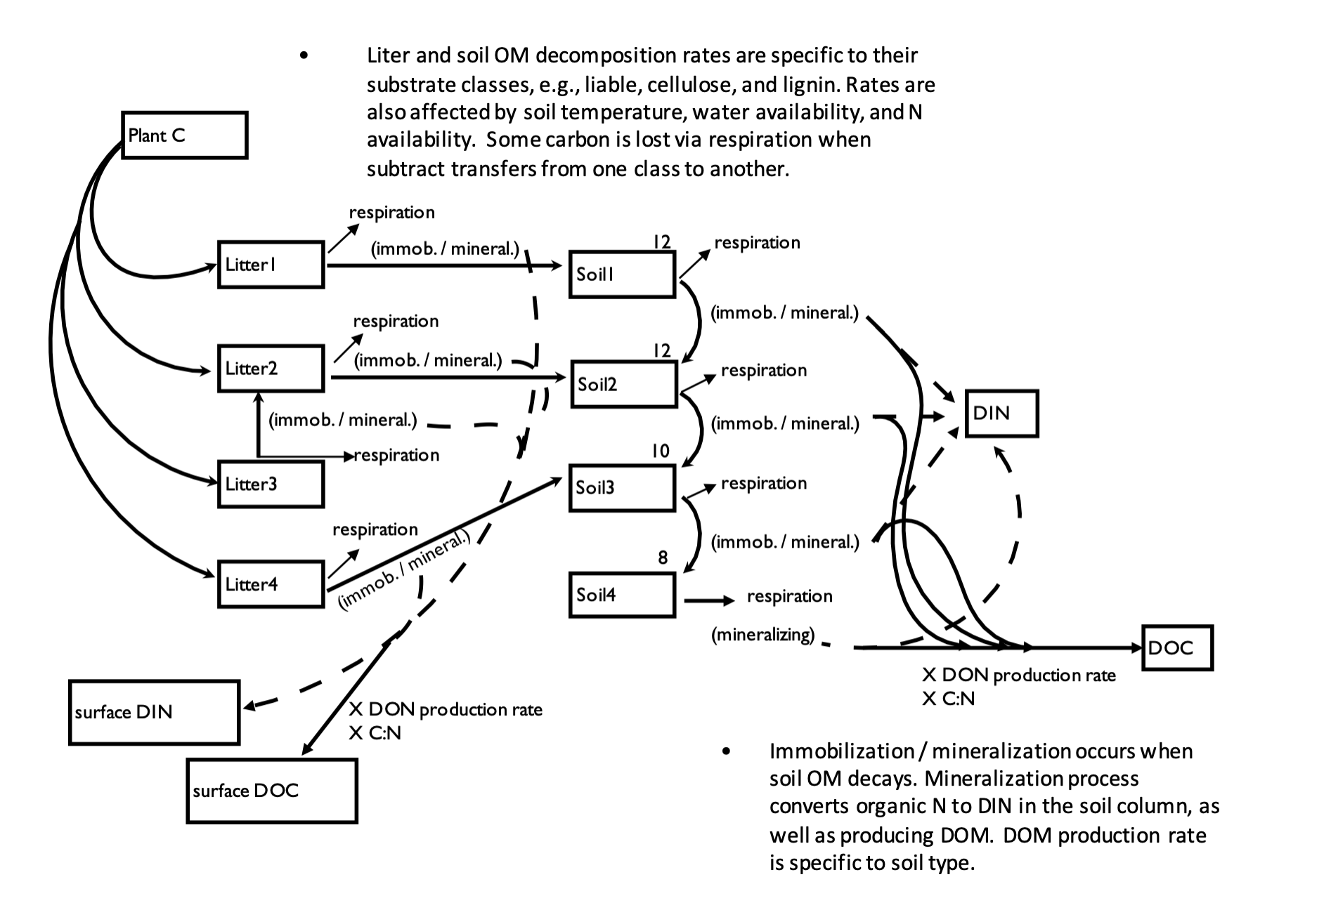
Canopy growth in RHESSys
RHESSys + stream model (Lin et al. 2015)
Decomposition in RHESSys

Slide 20
RHESSys (Lin et al. 2015)

Slide 21
Canopy growth in RHESSys (based on BiomeBGC)

Slide 22
Decomposition in RHESSys based on CENTURY model

Slide 23
Developing for urban catchment

Slide 24
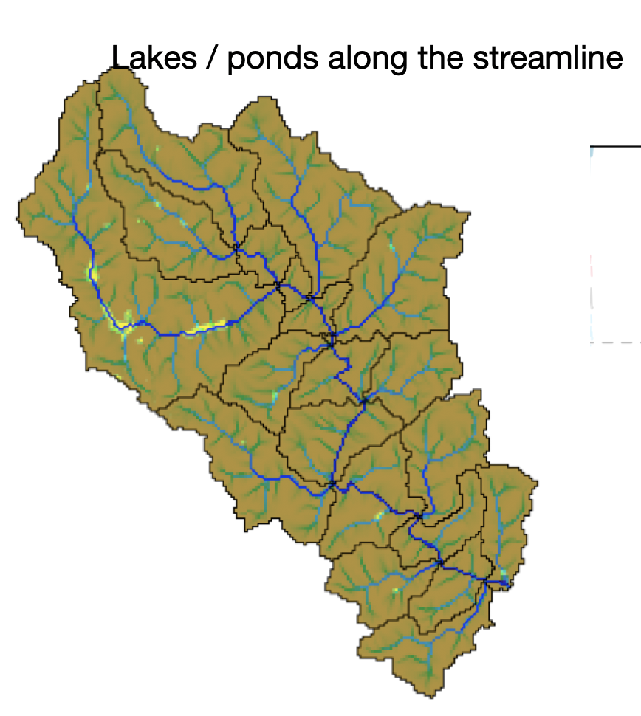
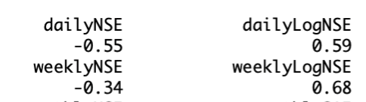
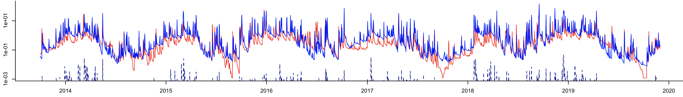
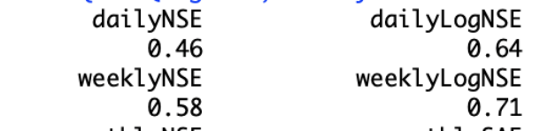
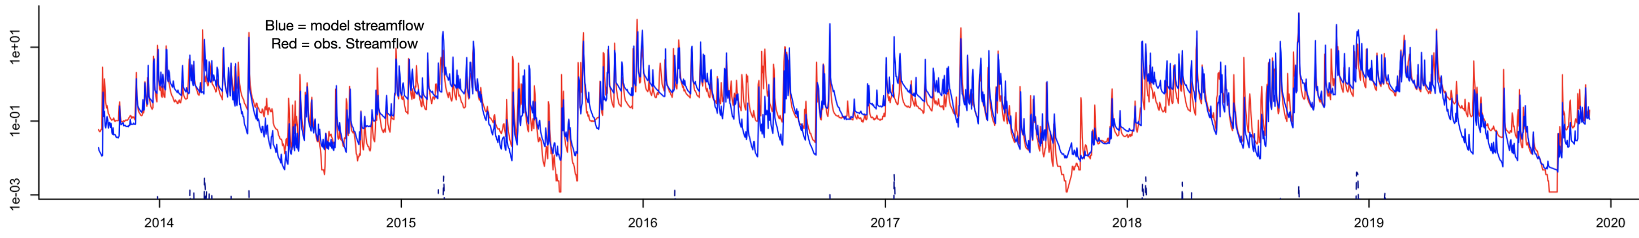
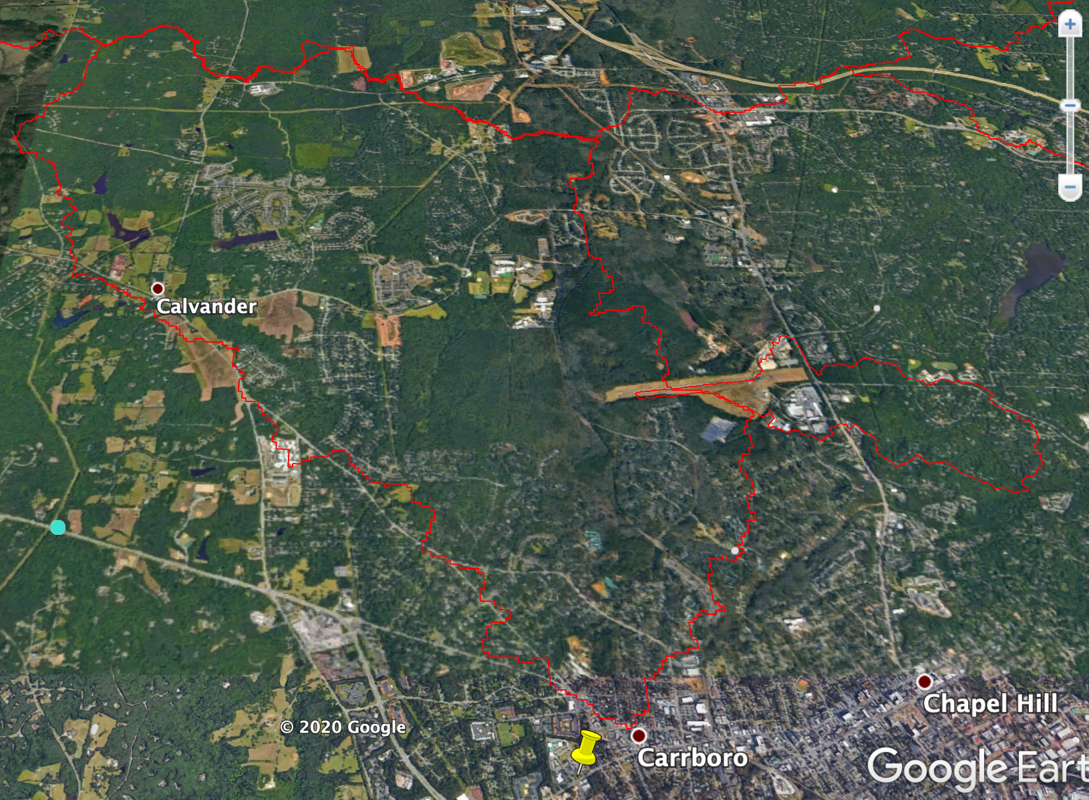
Ponds (~ 1 m deep)
No ponds
Yes ponds
20 km² Bolin, Chapel Hill, NC
Ponds

Slide 25
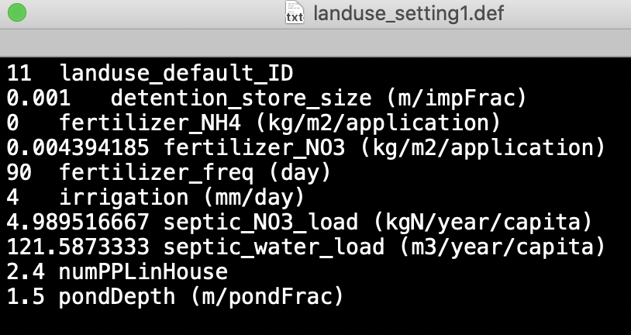

Ponds and Detention ponds
Transpiration
Precipitation
Evaporation
Canopy interception
(add more pond settings)
Drain from top
Returnflow
(drainDepth)
litter interception
(max drain rate)
Surface water (detention)
Infiltration
(permeable bottom)
Drain from some depth
Drain from bottom
Returnflow
Cap. Rise
Rooting depth
Infiltration
FC
Drainage
Detention pond designed drainage
Soil depth
Soil depth

Slide 26
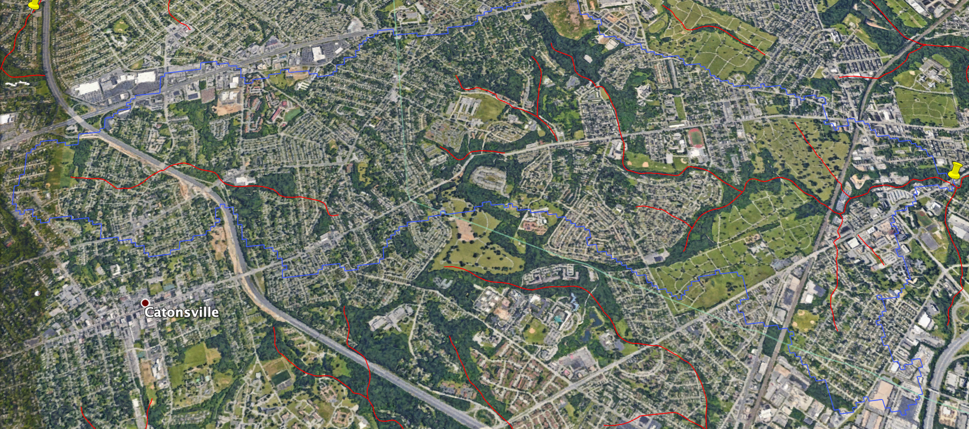
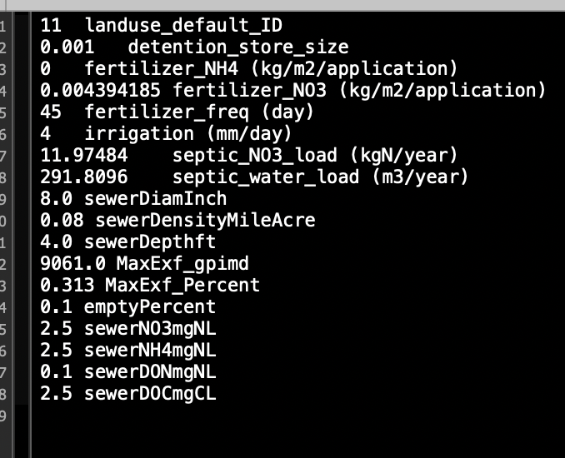
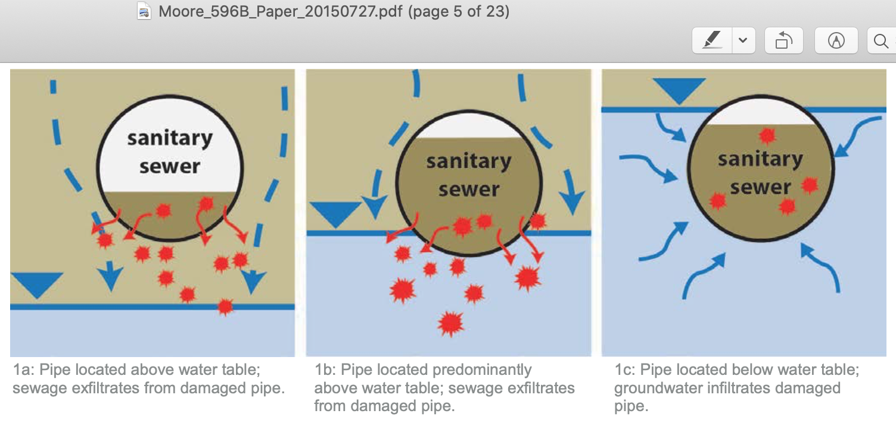
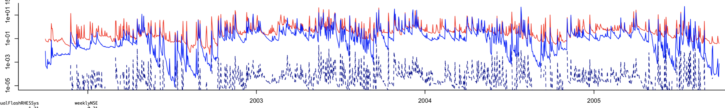
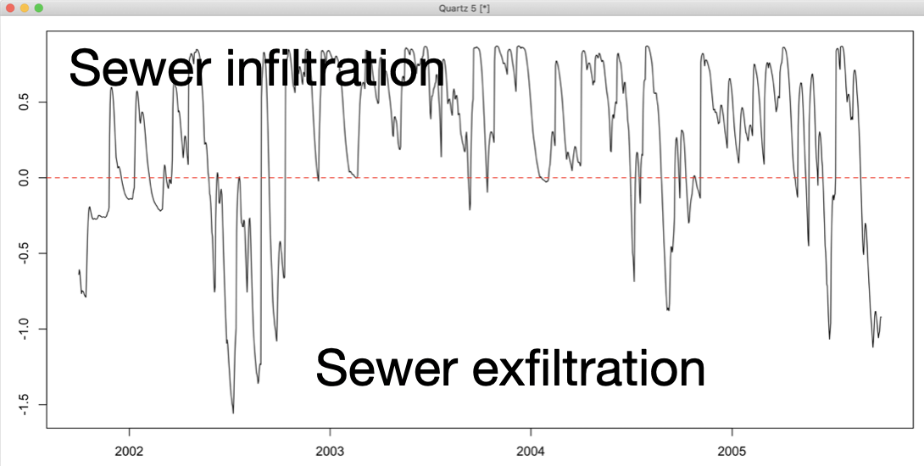
Sanitary sewer

Slide 27
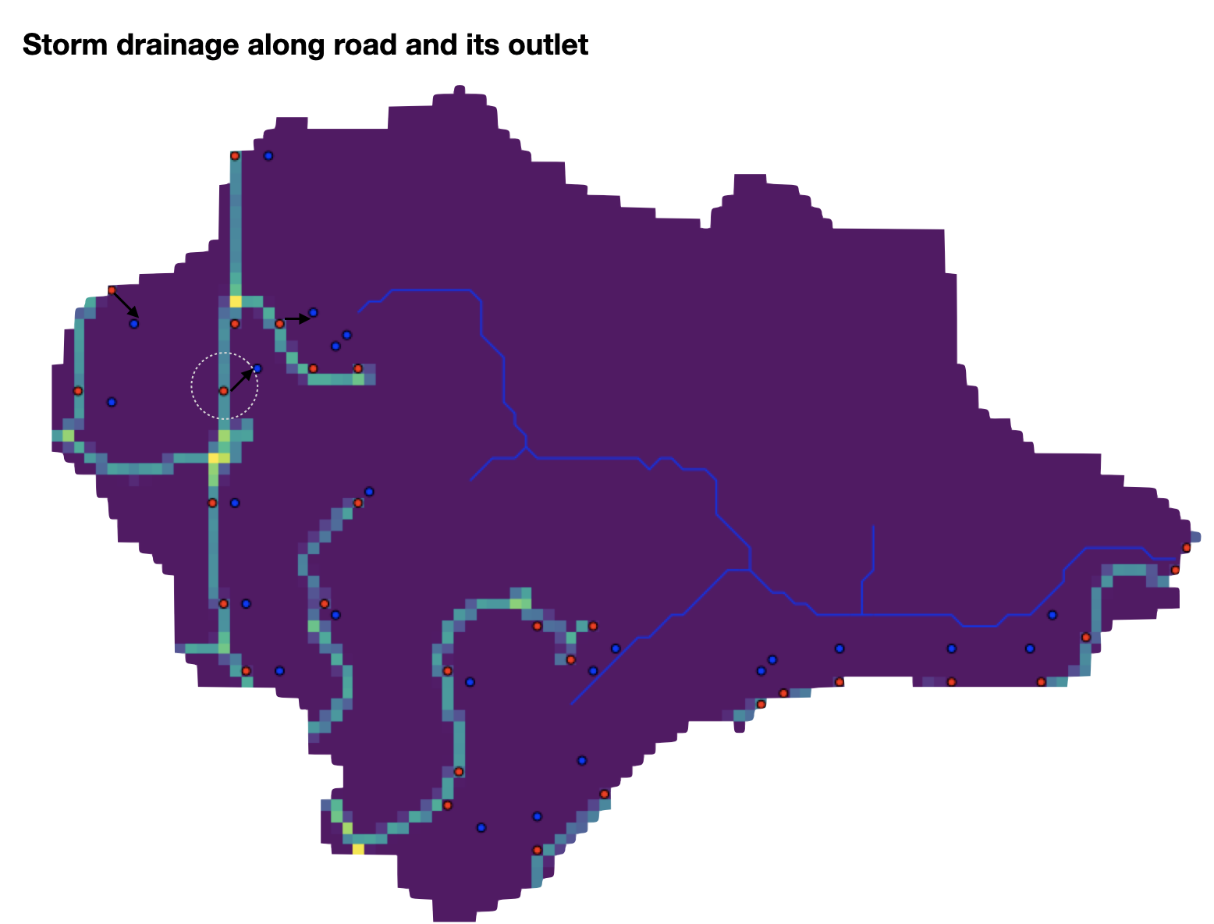
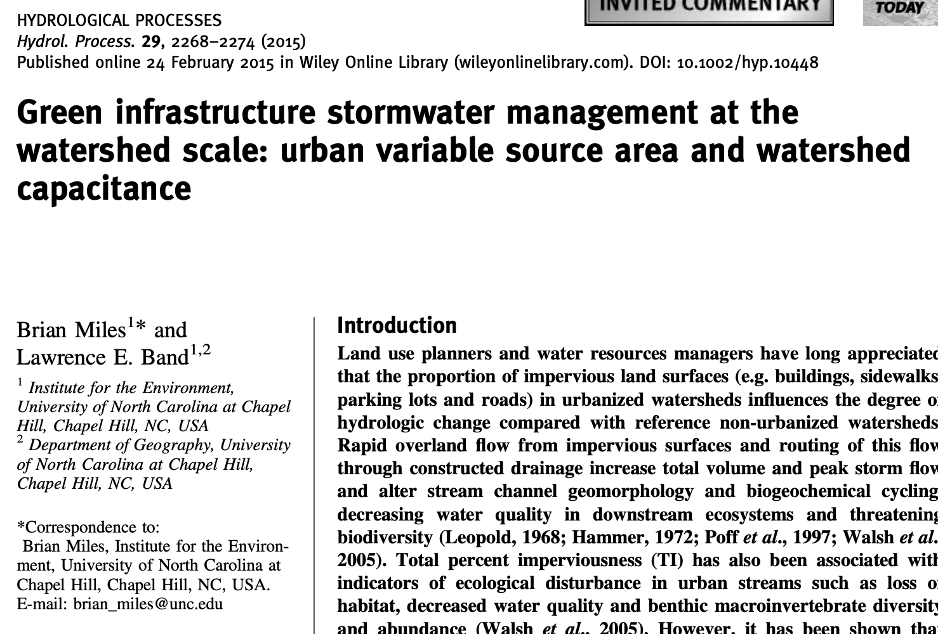
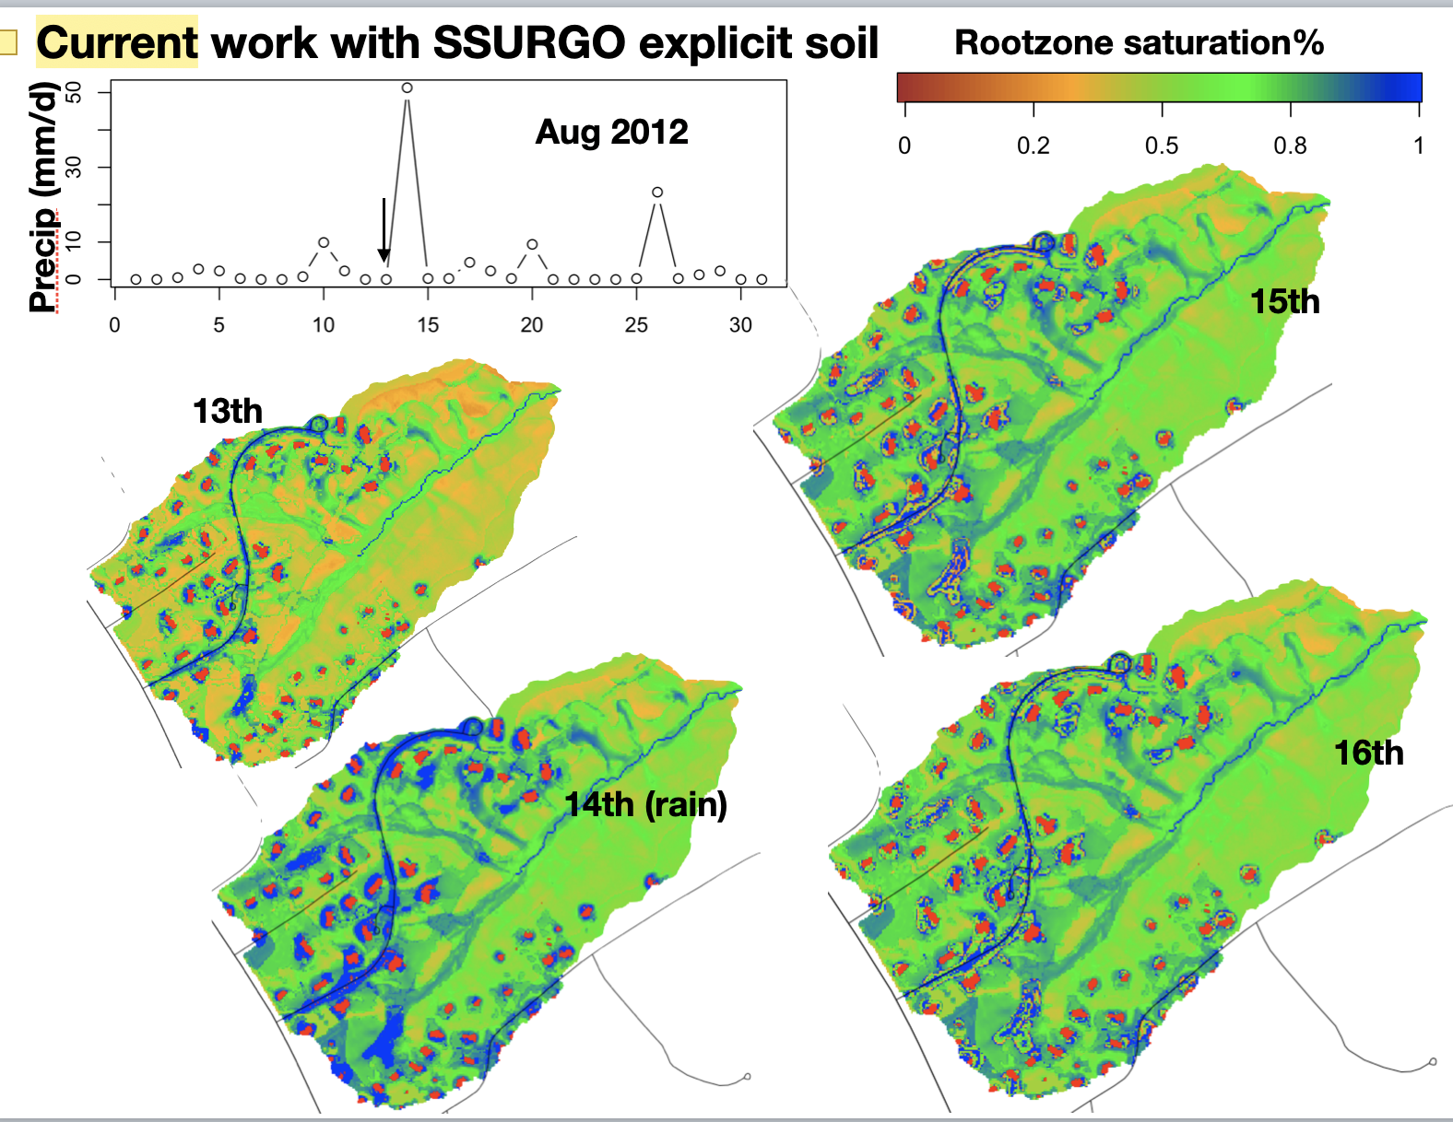
Engineering stormflow patterns
(disconnected) Rooftops -> adjacent previous areas (e.g., lawns and rain gardens) (low-impact development; LID)
(connected) Rooftops -> storm sewers
Surface routing
Quick flow
Use GIS to identify the transfer from A to B
Define transfer rate

Slide 28
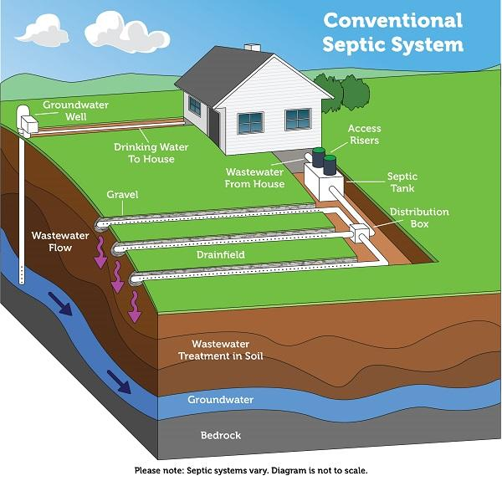
Water sources
Surface pond
Groundwater
Septic
Current Patch - subsurface (UNSAT)
Rain garden / irrigation
Irrigation
Current Patch - surface
Septic systems
Implementation
Flow table
actionCode 13 (irrigation)
In the neighbor rows:
In the current patch:
drainTO patches
patch
zone
hill
gamma fraction
shared perimeter / dist
shared perimeter
patch
zone
hill
float: X (useless)
float: Y (useless)
float: Z (useless)
int: 1 (useless)
basement_depth
drainage_type (x 13)
total_gamma
# of drainTO neighbors (not include “road” if drainage_type =2) (not include irrigation sources)
“road” patch
Change to “-# of drainIN neighbors”
patch
zone
hill
width
Withdraw water from somewhere from surface or deep underground
Release the withdrawn water to somewhere else on surface or in subsurface
drainIN patches
patch
zone
hill
Max daily withdrawal rate
Proportion of withdrawal from surface [0-1]
Proportion of withdrawal from this drainIN patch [0-1]

